Slide 1
THE QATARI DREAM
By Akinsemoyin Favour Temidayo

Slide 2
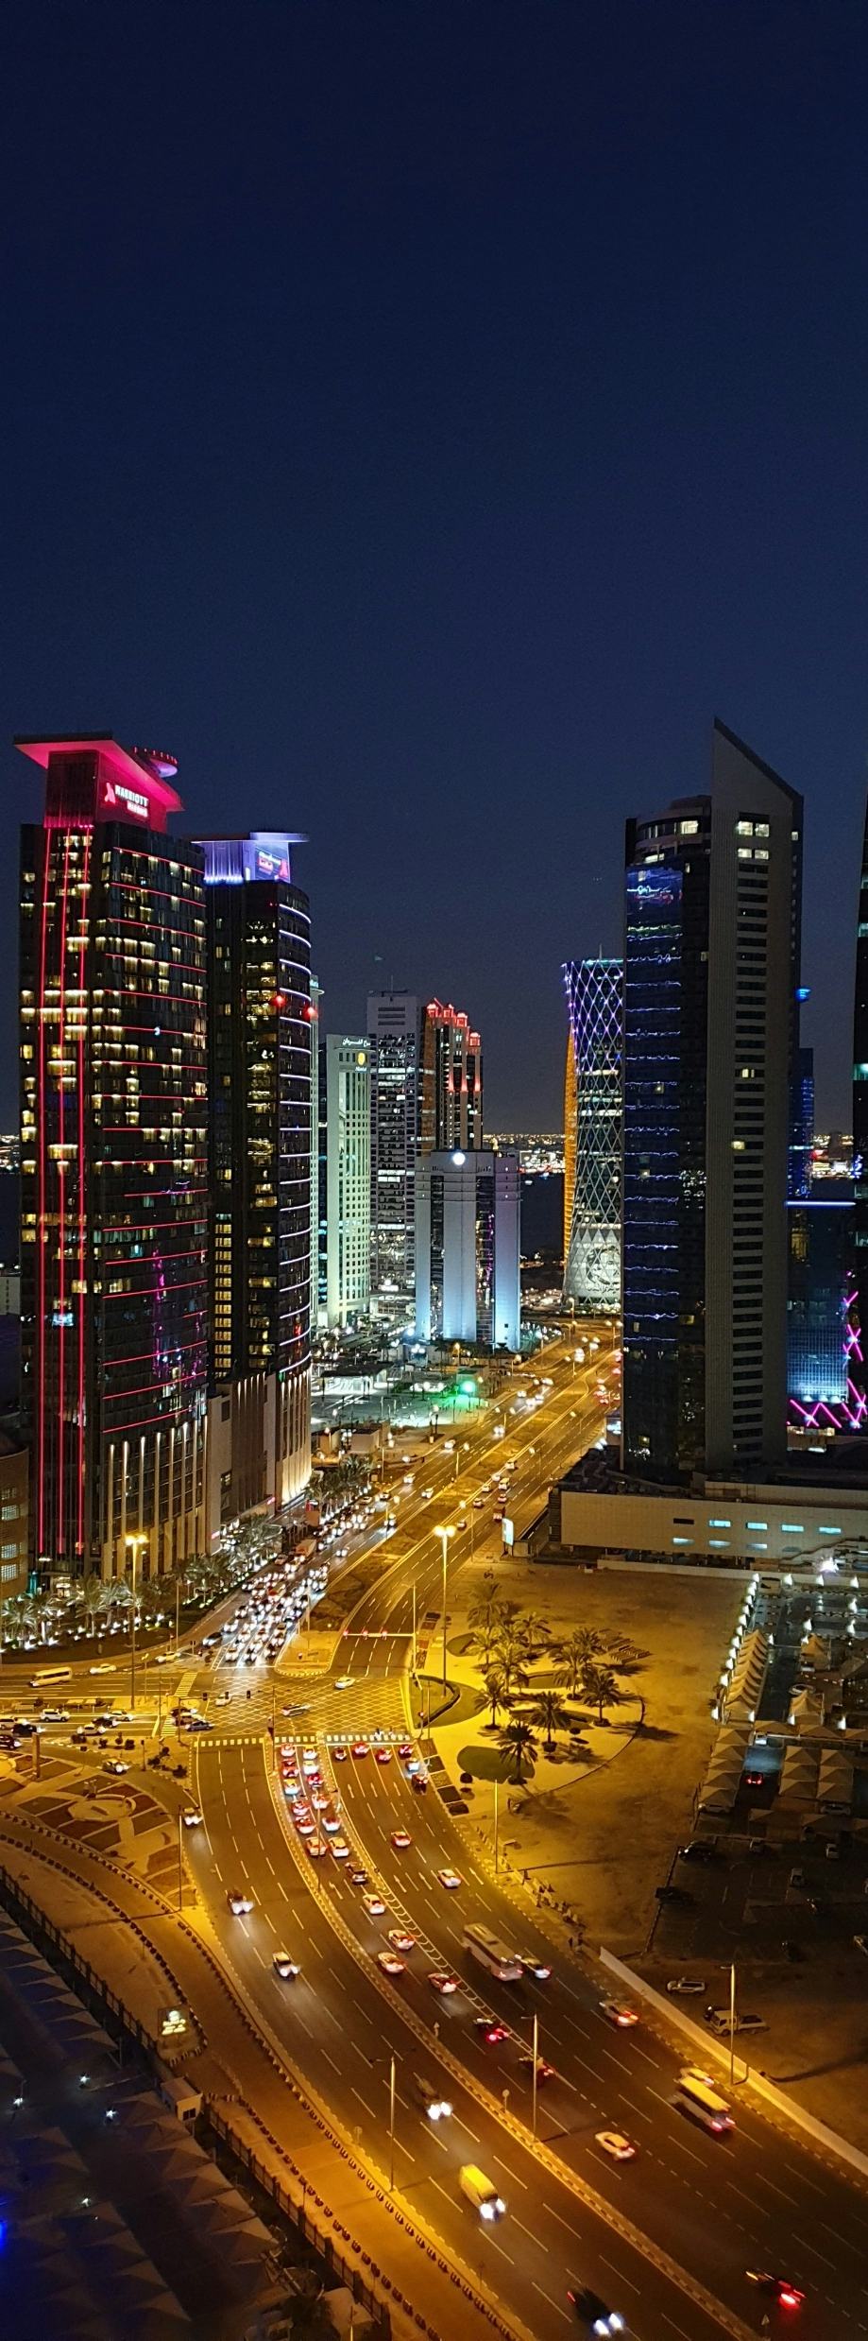
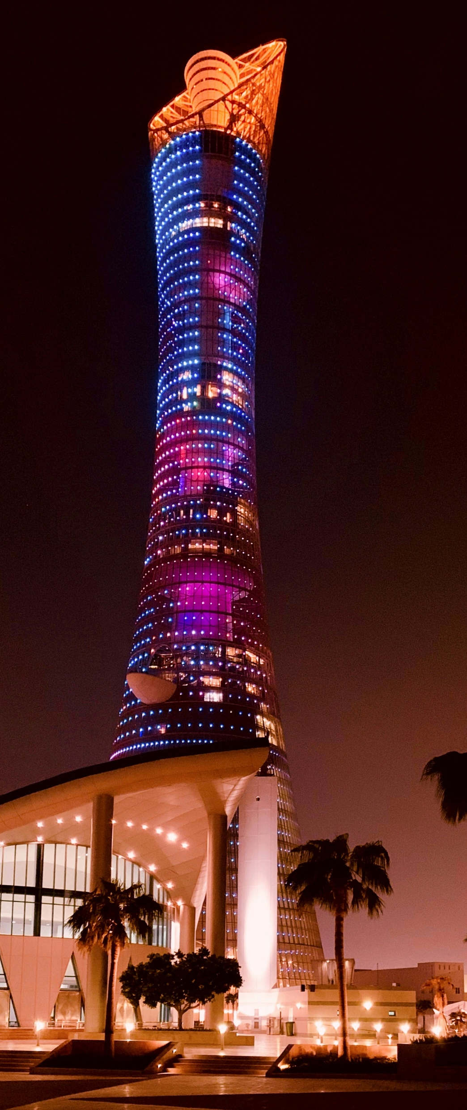

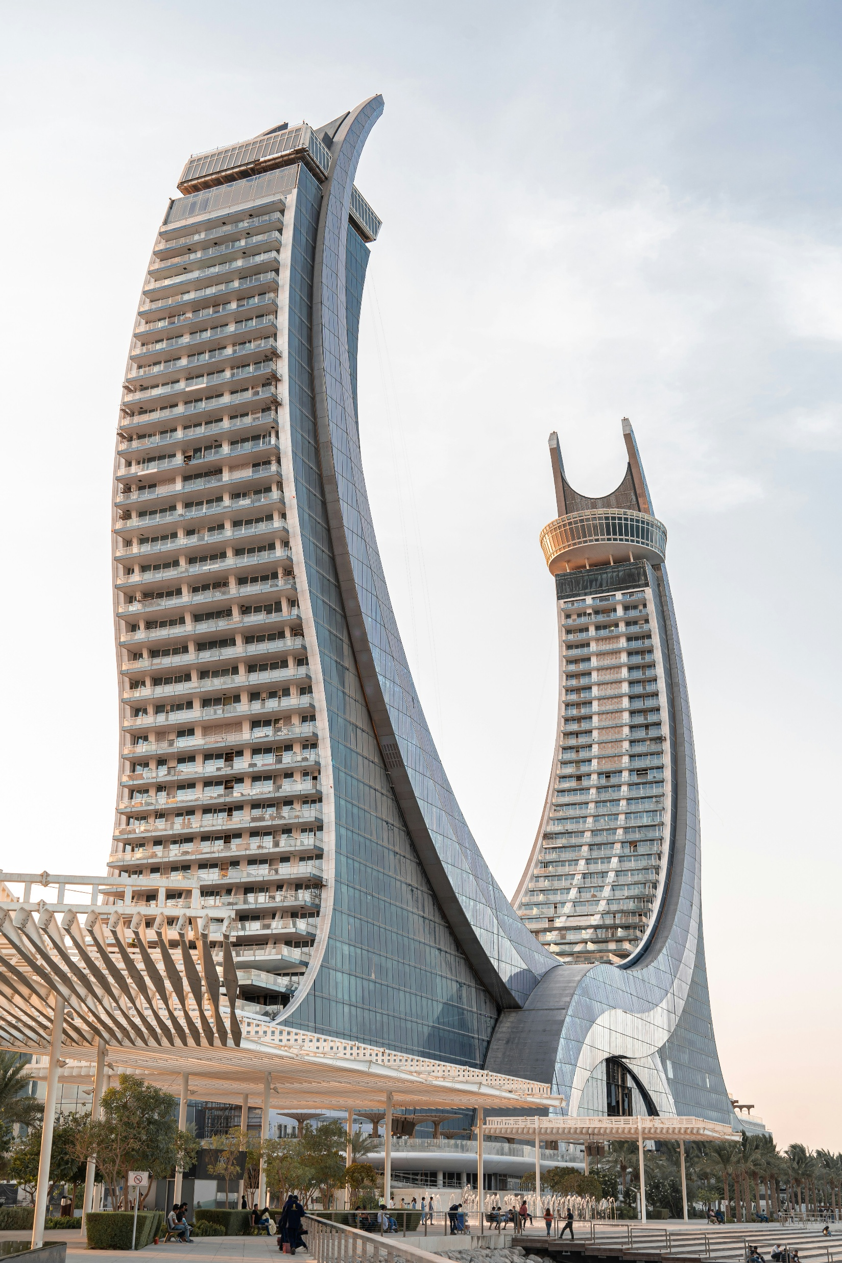
Introduction
Let’s go
Welcome to the Qatari Dream, a captivating story powered by data, showcasing Qatar's remarkable journey of resilience, growth, and boundless ambition

Slide 3
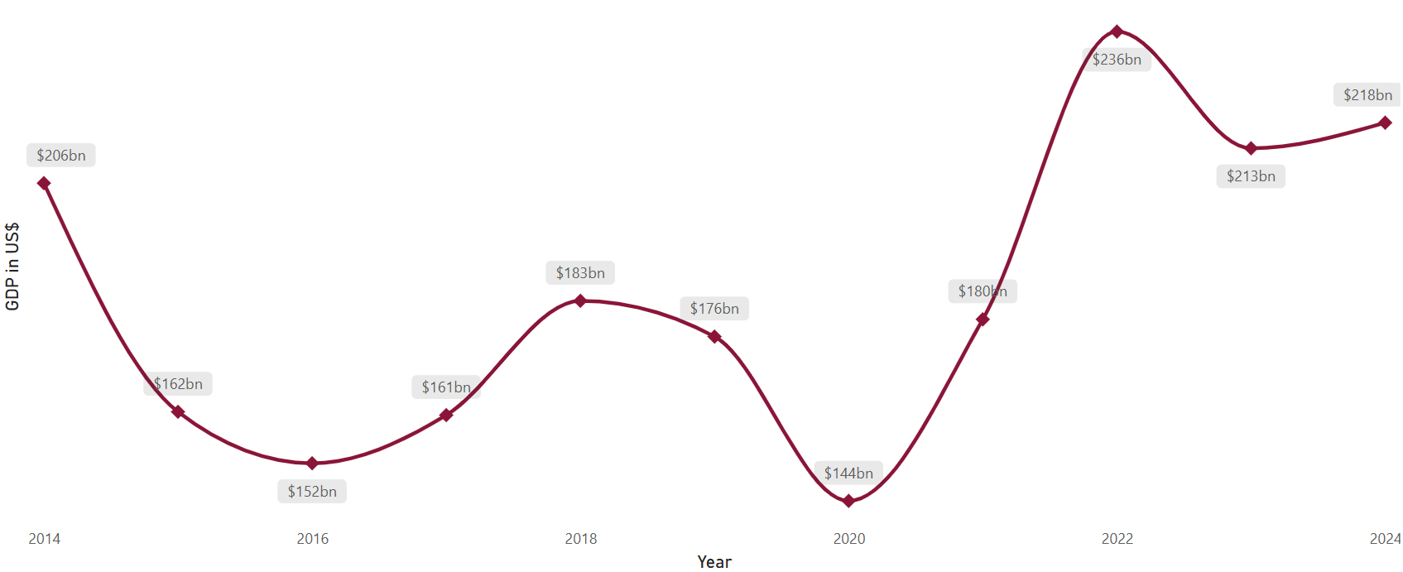

Qatar’s Economic Journey
Like almost every other country, Qatar’s GDP experienced a momentary dip during the COVID-19 pandemic. However, the country rebounded impressively.
Strong Economic Recovery: After a significant GDP drop to $144bn during the 2020 pandemic, Qatar impressively rebounded to reach $236bn in 2022, stabilizing around $218bn by 2024.
Resilient GDP per Capita: Despite global disruptions, Qatar's GDP per capita recovered consistently, reaching 89K QAR in 2022, indicating rising individual prosperity and sustained economic strength.
Improving Investment Climate & Stable Inflation: Post-pandemic, Qatar's foreign direct investment (FDI) turned positive again, coupled with controlled inflation rates, and one of the world's lowest unemployment figures at just 0.13%, highlighting investor confidence and sound economic management.

Slide 4
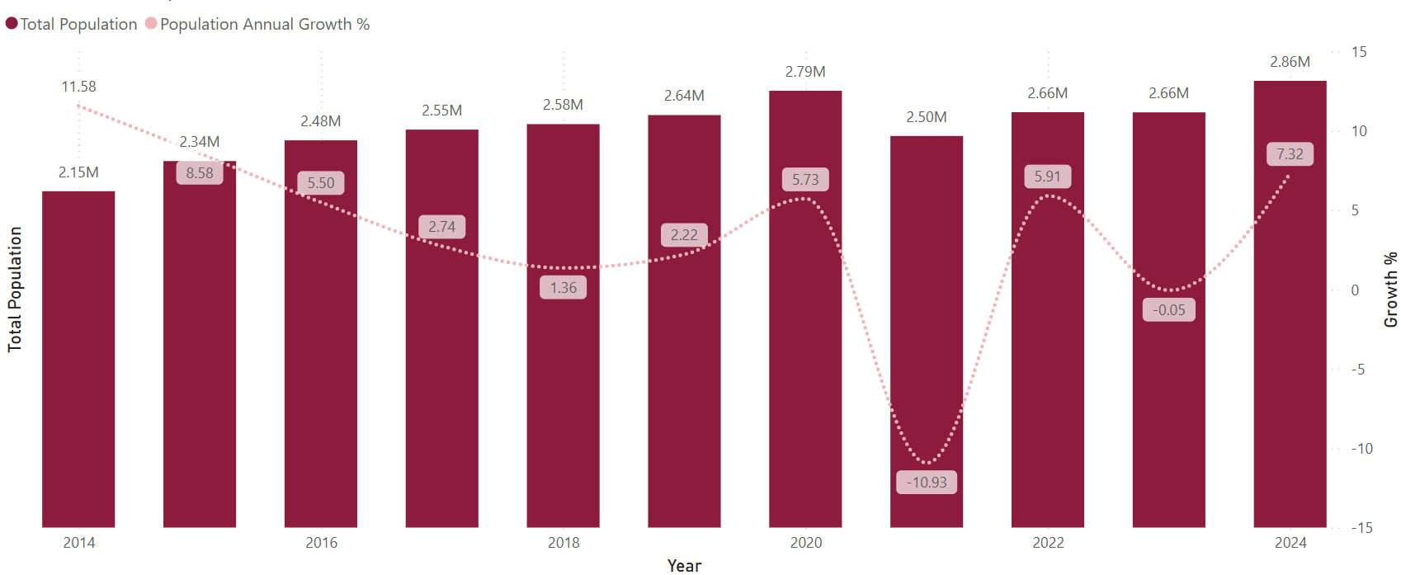

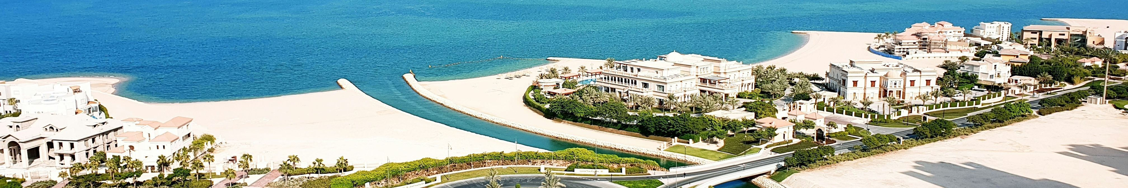
A vibrant Society: Qatar’s Population Story
Population Recovery: Qatar’s population dropped about 11% in 2021 due to COVID, but quickly recovered, growing over 7% by 2024 with a population of approximately 2.9 million residents.
Quality of Life Rising: Life expectancy in Qatar has steadily improved over the years, reaching 82 by 2024, showcasing progress in healthcare and overall quality of life.
Safe and Stable Society: Qatar’s unemployment sits at just 0.13%, and homicide rates remain below 0.5 per 100,000, making it one of the safest and most stable countries in the world.

Slide 5
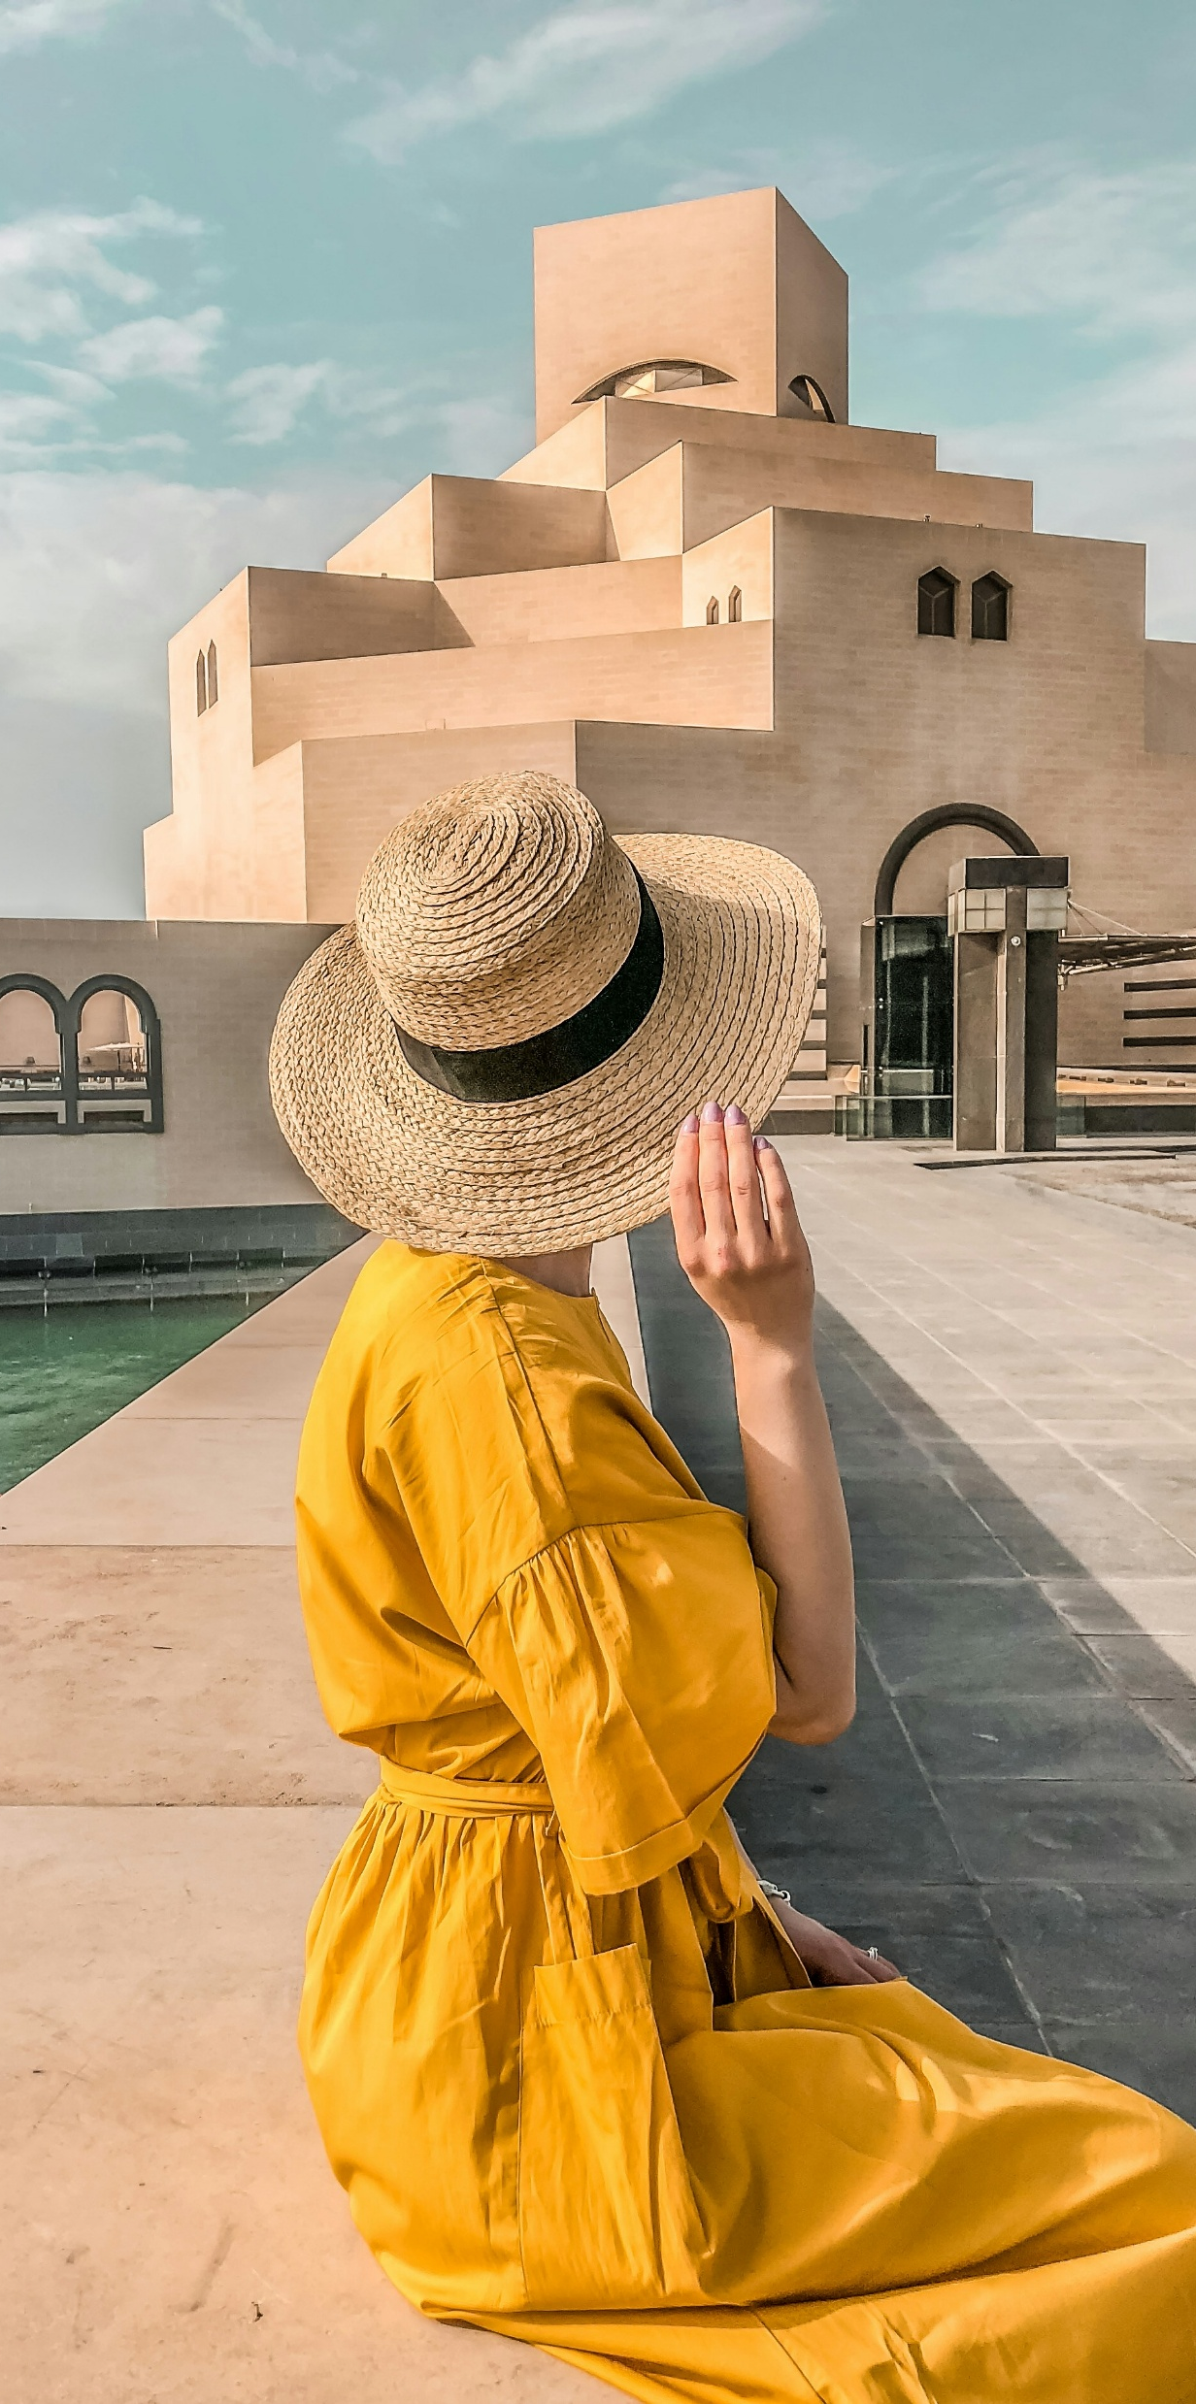



The Allure of Qatar
Tourism in Qatar has made a spectacular comeback since the quiet lockdown days. Visitors returned in droves, hitting a peak of over 5 million arrivals in 2024 alone. Not surprisingly, air travel, powered by Qatar Airways, remains the dominant gateway to this growing destination. Museums buzzed with eager tourists, the deserts filled with adventurers, and hotels filled up quickly, especially in cooler months, highlighting Qatar’s growing reputation as a must-visit destination
“ Qatar isn’t just open for business, it’s fast becoming a global destination where culture, luxury, and adventure meet. ”

Slide 6


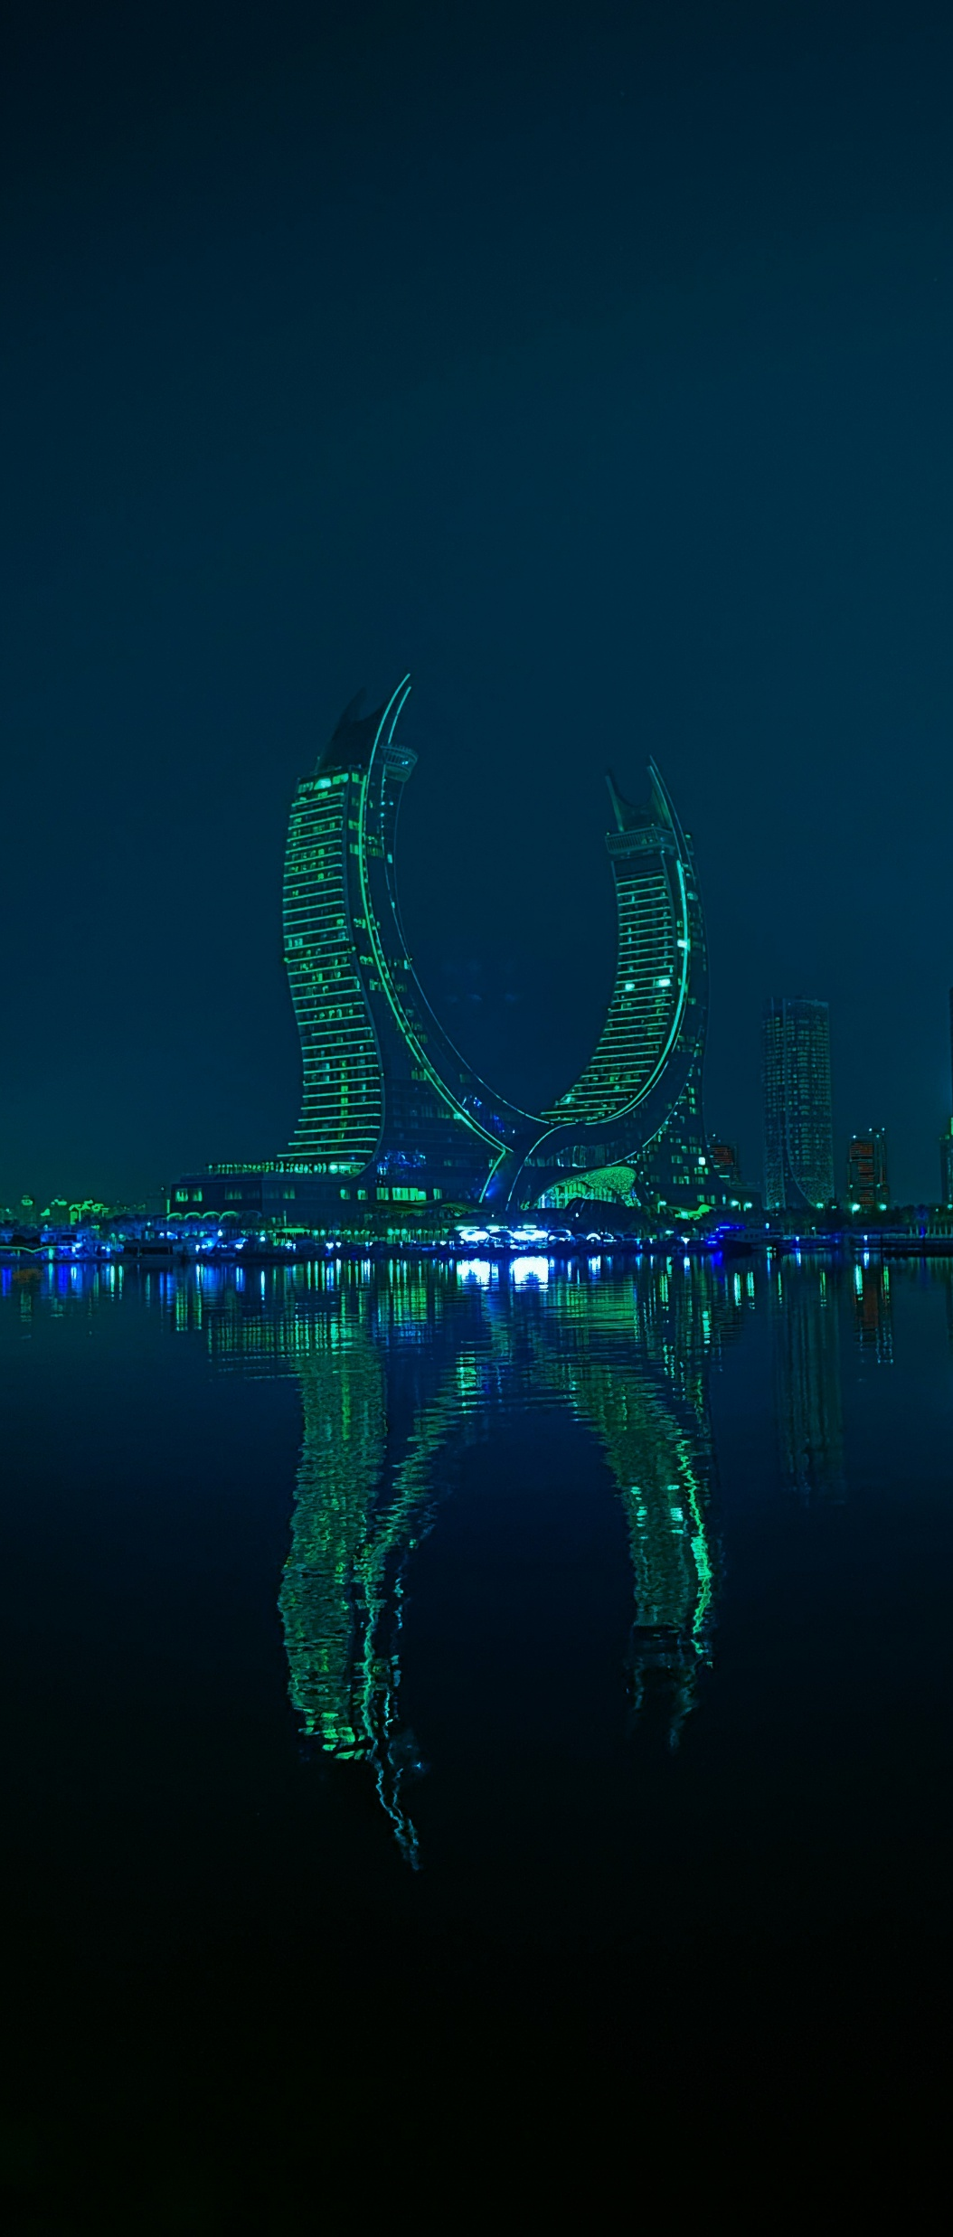


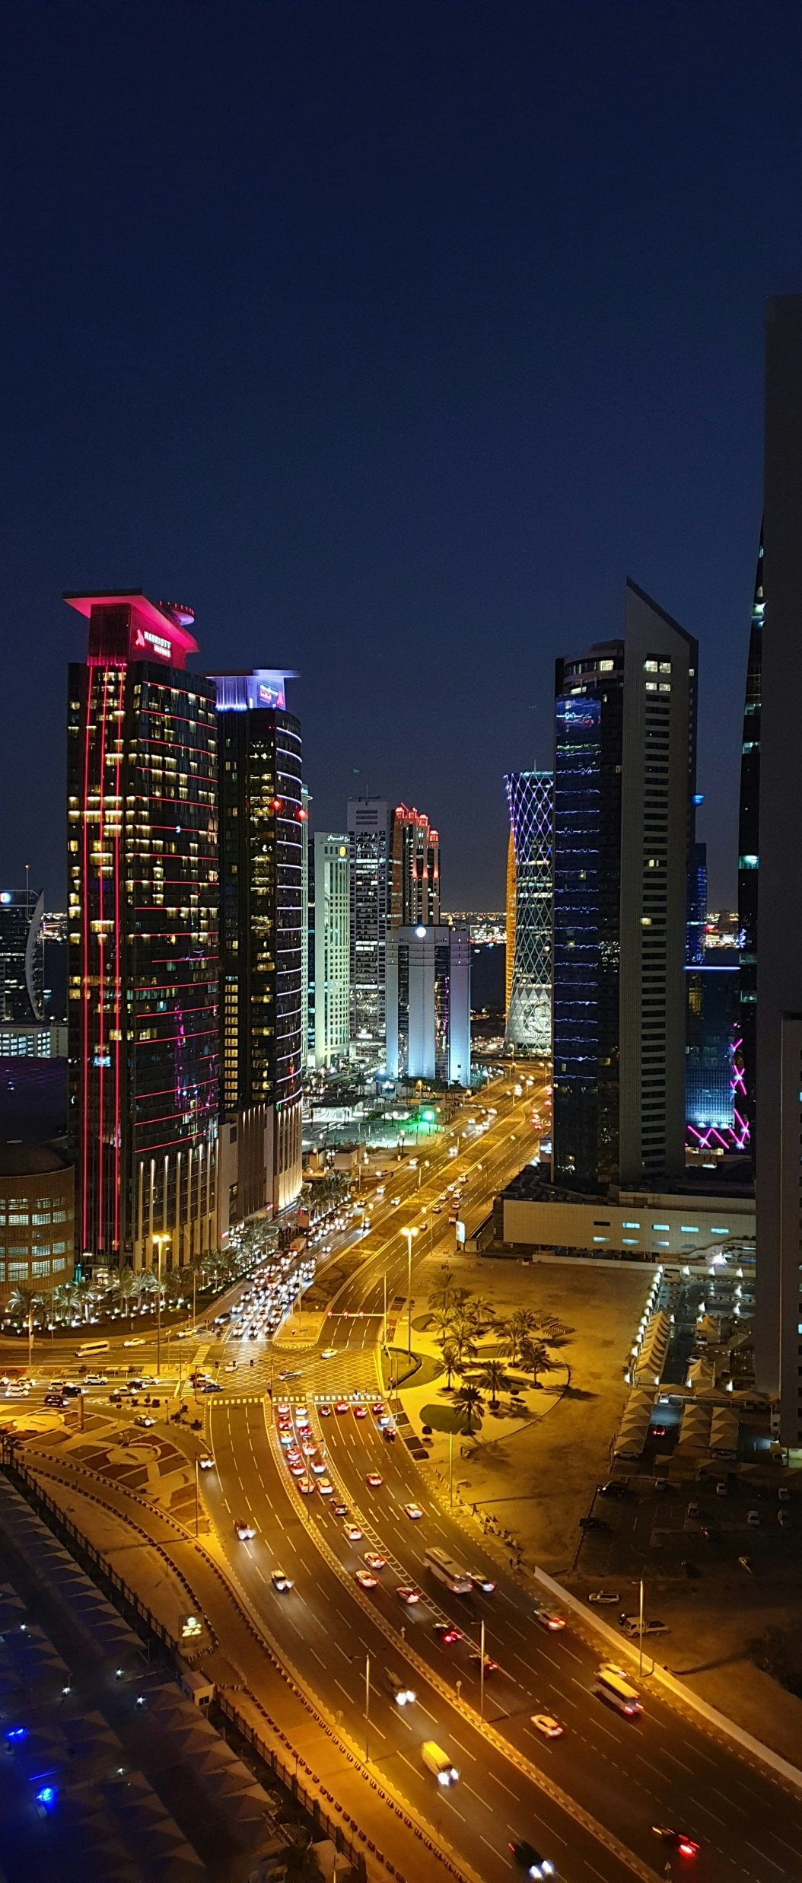
My Top Places to Visit in Qatar
Mina District
National Museum of Qatar
Corniche
Crescent Tower
Vendome Mall
Pearl Island
Villagio Mall
Katara
Qanat Quartier
Souq Waqif
Subzero Ice Lounge
Lusail Boulevard

Slide 7


Thank you
Akinsemoyin Favour Temidayo

